Slide 1
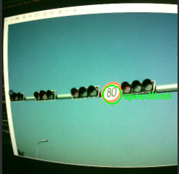


The SD-CSNN detects speed limit
Starts following procedures
Intercept the traffic sign zone in image
Serve as input
Number detection neural networks
Provides limited speed X
Yes
Current speed $≥$ X ?
Slow down
No
Keep original speed

